Slide 1

JUST MAGNIFICENT PROVIDER
WELLNESS MARKETING COMPANY

Slide 2



6
6
BAYANIHAN
MILLIONARES CLUB
Grab members are earnings because of the system they use.
They ENROLL the members to use the Grab system.
Benefits of members
Sure customers
Sure income Big income!!!
Convinient and Safe
So maraming benefits talaga.
GRAB MEMBERS EARNED MORE
BECAUSE OF THE SYSTEM
BAYANIHAN
MILLIONARES CLUB
BMC TINDAHAN PARTNERS are earning because of the
BMC System.
TINDAHAN PARTNERS ARE ENROLLED TO USE THE SYSTEM
Benefits of TINDAHAN PARTNERS
Sure REGULAR CUSTOMER
Sure income BIG BIG income too!!!
A chance to become like small 7/11 or Alfamart but the
price is lower.
HOW DOES IT WORK
CUSTOMERS OR MEMBERS MUST BUY ATLEAST A TOTAL OF P2000.00 WORTH OF PRODUCT TO HAVE A BAYANIHAN ACCOUNT
P2000.00= 70 POINT VALUE OR ONE SLOT

Slide 3
6
6
BAYANIHAN
MILLIONARES CLUB
TINDAHANPARTNER
SAMPLE COMPUTATION OF MONTHLY INCOME
100 FAMILIES
X 2000.00
P200,000.00 GROSS SALES
X 15%
P 30,000.00
______X 3_____
P90,000.00

Slide 4
6
6
BAYANIHAN
MILLIONARES CLUB
TINDAHANPARTNER
SIMPLE COMPUTATION OF MONTHLY INCOME
DIRECT REFERRALS
WORTH 4.8M BAYANIHAN INCOME
UNILEVELS INCOME AND MANY MORE!

Slide 5

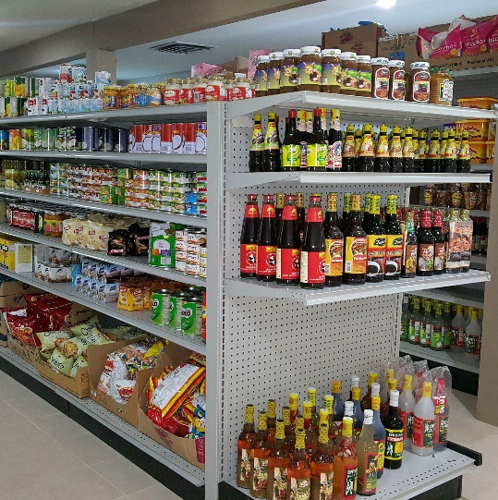
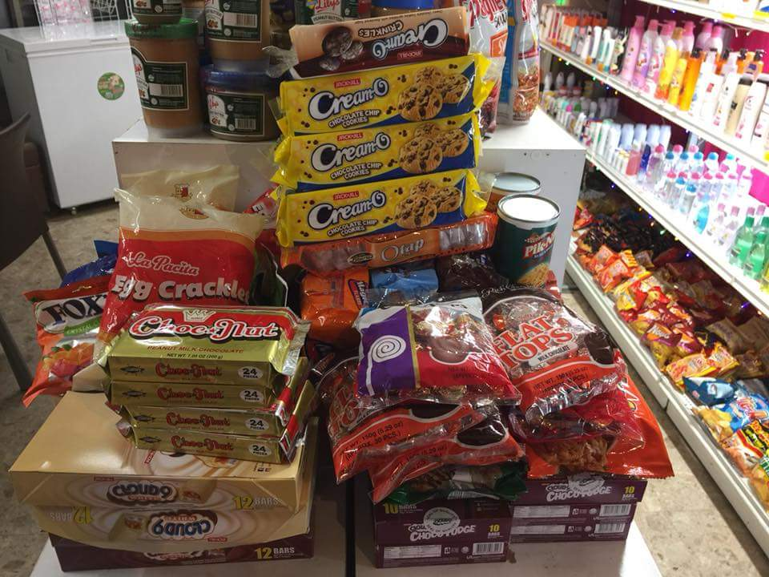
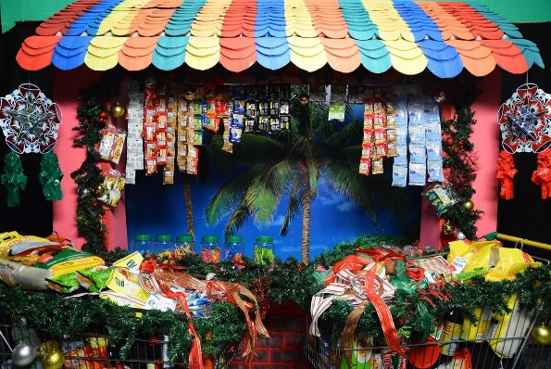
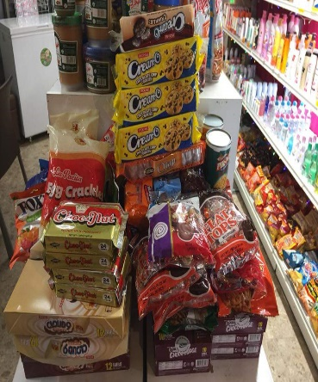
6
6
BAYANIHAN
MILLIONARES CLUB
EARN WHILE YOU SPEND!!!
JUST BUY ALL YOUR NEEDS
AND YOU WILL EARN MORE…
WANT TO KNOW HOW???
ASK OUR TINDAHAN PARTNERS.

Slide 6
6
6
BAYANIHAN
MILLIONARES CLUB
Grab members are earnings because of the system they use.
They ENROLL the members to use the Grab system.
Benefits of members
Sure customers
Sure income Big income!!!
GRAB MEMBERS EARNED MORE
BECAUSE OF THE SYSTEM
BAYANIHAN
MILLIONARES CLUB
BMC TINDAHAN PARTNERS are earnings because of
BMC system.
Benefits of partners
Sure customer
Sure income BIG BIG income too!!!
A chance to become like small 7/11 or Alfamart but
low price.
HOW DOES IT WORK?
Enroll your customer to our system.
You will buy codes or coupons to us that will use to enroll your customers.
There are 4 coupons to use.
Green = 1PV Pink= 0.50 PV
White= 0.25 PV
Orange= Special PV.
Every product that customers buy has a Point Value.
Example.
1kilo of rice = 1PV/ GREEN COUPON
1 SACHET TWIN PACK COFFEE= 0.50 PV PINK COUPON
1 SACHET SHAMPOO= 0.25 PV/ WHITE COUPON
OR COMBINATION = ORANGE COUPON
If the customer already earn 200 point value,
THEN WE ENROLL IT TO BAYANIHAN SYSTEM

Slide 7

6
6
BAYANIHAN
MILLIONARES CLUB
EARN 200 POINT VALUE JUST BY BUYING GROCERIES TO OUR TINDAHAN PARTNERS.
200 PV
=
ONE SLOT
FOR BAYANIHAN

Slide 8
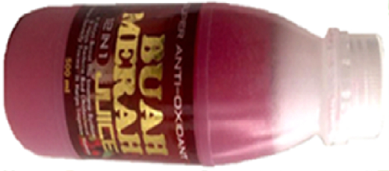
6
BAYANIHAN
MILLIONARES CLUB
NATIONWIDE COVERAGE
DAVAO
CEBU
BENEFITS A MEMBER
GENSAN
ILOILO
MANILA
NAGA
EARN P 20 FOR EVERY REFERRAL
CHANCE TO EARN UP TO 2.4M
LUZON
VISAYAS
MINDANAO
BAYANIHAN SYSTEM
O
OOOOO
5X5 = P25
25X5 = P125
125X5 = P625
625X5 = P3,125
3125x5 = P15,625
15625X5 = P78,125
78125X5 =P390,625
390625X5 = P1,953,125
OOOOOOOOOOOOOOOOOOOOOOOOO
OOOOOOOOOOOOOOOOOOOOOOOOO
OOOOOOOOOOOOOOOOOOOOOOOOO
OOOOOOOOOOOOOOOOOOOOOOOOO
OOOOOOOOOOOOOOOOOOOOOOOOO
OOOOOOOOOOOOOOOOOOOOOOOOO
OOOOOOOOOOOOOOOOOOOOOOOOO

Slide 9

6
6
BAYANIHAN
MILLIONARES CLUB
1ST Level = 5x10= P50
6th Level =15625 x10= P156250
7thLevel 78125 x10= P781250
2nd Level =25x10= P250
3rd Level =125x10= P1250
4th Level = 625x10= P6250
5th Level =3125 x10= P31250
8th Level =390625 x10= P3906250
TOTAL OF 4.8 MILLION

Slide 10


OR
Just simply buy
1 bottle
for
Buah Merah
500 ml
P350.00
ONLY
You will be a member Bayanihan Millionares’
Club
JUST MAGNIFICENT PROVIDER WELLNESS MARKETING COMPANY

Slide 12


Slide 13
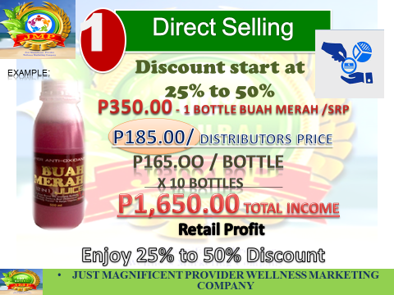
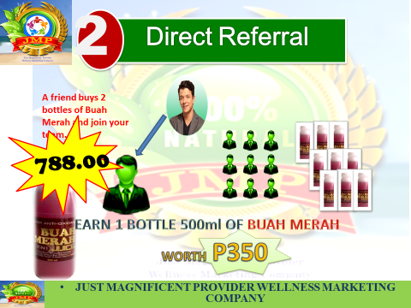
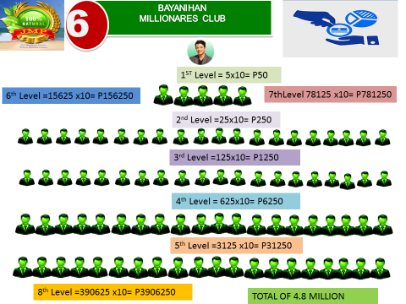
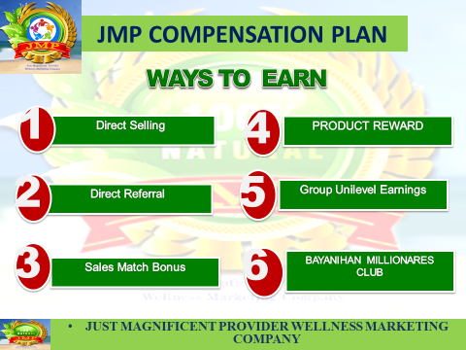
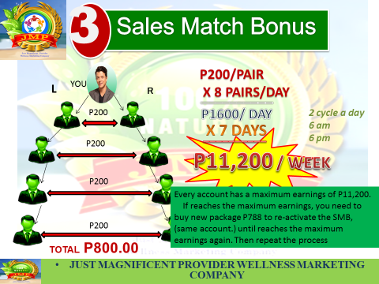
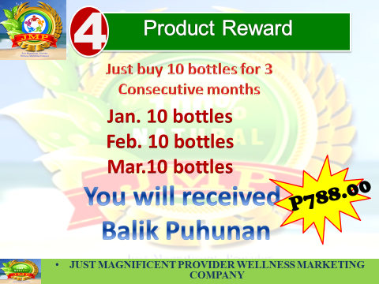
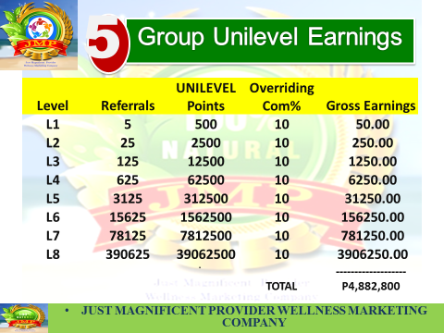
FULL PLEDGE MEMBER
AJMP NETWORK

Slide 14


JMP COMPENSATION PLAN
WAYS TO EARN
1
4
Direct Selling
PRODUCT REWARD
2
5
Direct Referral
Group Unilevel Earnings
3
6
Sales Match Bonus
BAYANIHAN MILLIONARES CLUB
JUST MAGNIFICENT PROVIDER WELLNESS MARKETING COMPANY

Slide 15

1
Direct Selling
Discount start at 25% to 50%
EXAMPLE:
P350.00 - 1 BOTTLE BUAH MERAH /SRP
P185.00/ DISTRIBUTORS PRICE
P165.OO / bottle
X 10 BOTTLES
P1,650.00 TOTAL INCOME
Retail Profit
Enjoy 25% to 50% Discount
JUST MAGNIFICENT PROVIDER WELLNESS MARKETING COMPANY

Slide 16



2
Direct Referral
A friend buys 2 bottles of Buah Merah and join your team.
P698.00
788.00
EARN 1 BOTTLE 500ml OF BUAH MERAH
WORTH P350
JUST MAGNIFICENT PROVIDER WELLNESS MARKETING COMPANY

Slide 17
3
Sales Match Bonus
P200/PAIR
X 8 PAIRS/DAY
L
YOU
R
__________
P1600/ DAY
P200
2 cycle a day
6 am
6 pm
X 7 DAYS
__________
1
P200
P11,200 / WEEK
P200
Every account has a maximum earnings of P11,200.
If reaches the maximum earnings, you need to buy new package P788 to re-activate the SMB, (same account.) until reaches the maximum earnings again. Then repeat the process
P200
TOTAL P800.00
JUST MAGNIFICENT PROVIDER WELLNESS MARKETING COMPANY

Slide 18
4
Product Reward
Just buy 10 bottles for 3
Consecutive months
Jan. 10 bottles
Feb. 10 bottles
Mar.10 bottles
You will received
Balik Puhunan
P788.00
JUST MAGNIFICENT PROVIDER WELLNESS MARKETING COMPANY

Slide 19
4
Product Reward
Just buy 10 bottles for 3
Consecutive months
Jan. 10 bottles
Feb. 10 bottles
Mar.10 bottles
5 B0ts.
Buah
You will received
Balik Puhunan
JUST MAGNIFICENT PROVIDER WELLNESS MARKETING COMPANY

Slide 20
5
Group Unilevel Earnings
Level | Referrals | UNILEVEL Points | Overriding Com% | Gross Earnings
L1 | 5 | 500 | 10 | 50.00
L2 | 25 | 2500 | 10 | 250.00
L3 | 125 | 12500 | 10 | 1250.00
L4 | 625 | 62500 | 10 | 6250.00
L5 | 3125 | 312500 | 10 | 31250.00
L6 | 15625 | 1562500 | 10 | 156250.00
L7 | 78125 | 7812500 | 10 | 781250.00
L8 | 390625 | 39062500 | 10 | 3906250.00
 |  |  | TOTAL | ------------------- P4,882,800
.
JUST MAGNIFICENT PROVIDER WELLNESS MARKETING COMPANY

Slide 21
6
BAYANIHAN
MILLIONARES CLUB
NATIONWIDE COVERAGE
DAVAO
CEBU
BENEFITS A MEMBER
GENSAN
ILOILO
EARN P 50 FOR EVERY REFERRAL
CHANCE TO EARN UP TO 4.8M
MANILA
NAGA
LUZON
VISAYAS
BAYANIHAN SYSTEM
MINDANAO
O
OOOOO
5X10 = 50
25X10 = 250
125X10 = 1250
625X10 = 6250
3125X10 = 31250
15625X10 = 156250
78125X10 = 781250
390625X10 = 3906250
OOOOOOOOOOOOOOOOOOOOOOOOO
OOOOOOOOOOOOOOOOOOOOOOOOO
OOOOOOOOOOOOOOOOOOOOOOOOO
OOOOOOOOOOOOOOOOOOOOOOOOO
OOOOOOOOOOOOOOOOOOOOOOOOO
OOOOOOOOOOOOOOOOOOOOOOOOO
OOOOOOOOOOOOOOOOOOOOOOOOO

Slide 22



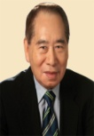









Simple Concept of Network Marketing
MORE…
SMC
CONDOS
Net Worth $3 Billion
Customers
Deposits/Loans
P150,000,000,000
JUST MAGNIFICENT PROVIDER WELLNESS MARKETING COMPANY

Slide 24
P698.00
“ONE TIME ENTRY”
YOU
WEEK ONE
LEFT | RIGHT | INCOME
MONDAY 1 1 P200.00
TUESDAY 3 3 600.00
WEDNESDAY 6 6 1,200.00
THURSDAY 8 8 1,600.00
FRIDAY 4 4 800.00
SATURDAY 5 5 1,000.00
1 WEEK LANG!!!
SUNDAY 8 8 1,600.00
TOTAL P7,000
JUST MAGNIFICENT PROVIDER WELLNESS MARKETING COMPANY

Slide 25
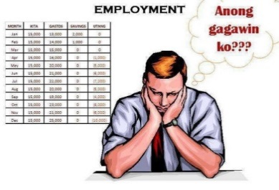
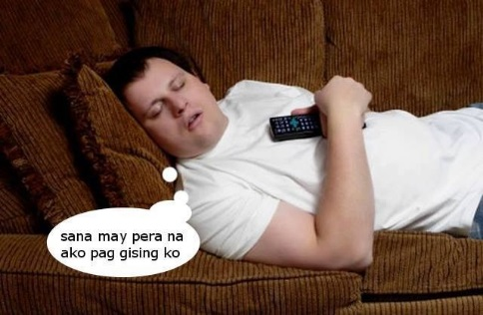
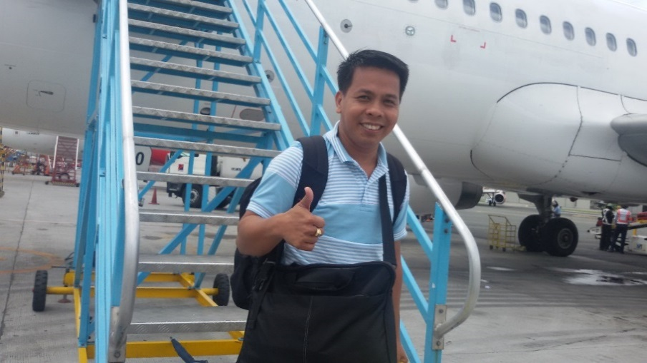
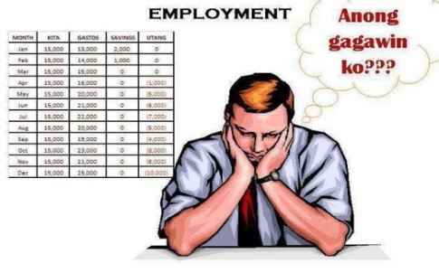

“The Power of Multiple Accounts”
Same Time and same Effort..!
JUST MAGNIFICENT PROVIDER WELLNESS MARKETING COMPANY

Slide 26
“The Power of Multiple Accounts”
P1,600/DAY
TOTAL OF
P11,200/DAY
P1,600/DAY
P1,600/DAY
P78,400/WEEK
P1,600/DAY
P1,600/DAY
P1,600/DAY
P1,600/DAY
7 HEADS ACCOUNT
JUST MAGNIFICENT PROVIDER WELLNESS MARKETING COMPANY

Slide 27
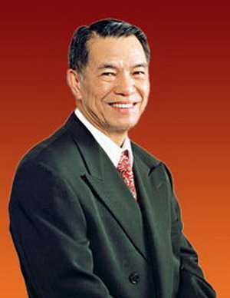
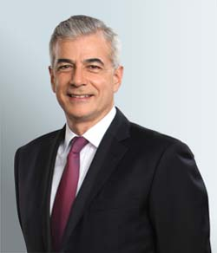

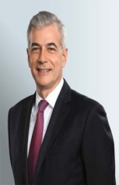

Simple Concept of Network Marketing
Company Safety Net
-----------------------------------
1Package/BC – 65pairs
pairs per level side lock…
3Packages/BC – 90pairs
pairs per level side lock…
7Packages/BC – 130pairs
pairs per level side lock…
JUST MAGNIFICENT PROVIDER WELLNESS MARKETING COMPANY

Slide 28
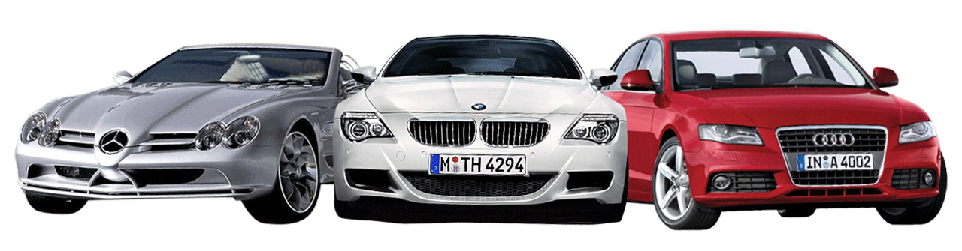

6
Car & Travel Incentives
To follow
JUST MAGNIFICENT PROVIDER WELLNESS MARKETING COMPANY

Slide 29
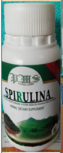

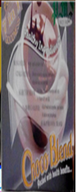
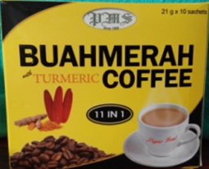
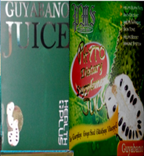
7
Stockists / Product Service Center
Appliances mo
hulugan ko promo
JUST MAGNIFICENT PROVIDER WELLNESS MARKETING COMPANY

Slide 30
THANK YOU AND GOD BLESS
JUST MAGNIFICENT PROVIDER WELLNESS MARKETING COMPANY

Slide 31
JUST MAGNIFICENT PROVIDER WELLNESS MARKETING COMPANY

Slide 32



